Slide 1
P1666.1
SystemC Analog/Mixed-Signal (AMS) extensions
Working Group
January 5, 2015 | Martin Barnasconi | P1666.1 Chair

Slide 2
Call to order &
Roll CAll
Current roster:
Sumit Adhikari, NXP Semiconductors
Martin Barnasconi, NXP Semiconductors
Dennis Brophy, Mentor Graphics
Kevin Cameron, Synopsys Inc.
Fabio Cenni, STMicroelectronics
Joe Daniels, Accellera representative
Karsten Einwich, Fraunhofer IIS/EAS
Paul Floyd, Atrenta Inc.
Olivier Guillaume, STMicroelectronics
Mladen Nizic, Cadence Design Systems
Gerhard Noessing, Lantiq

Slide 3
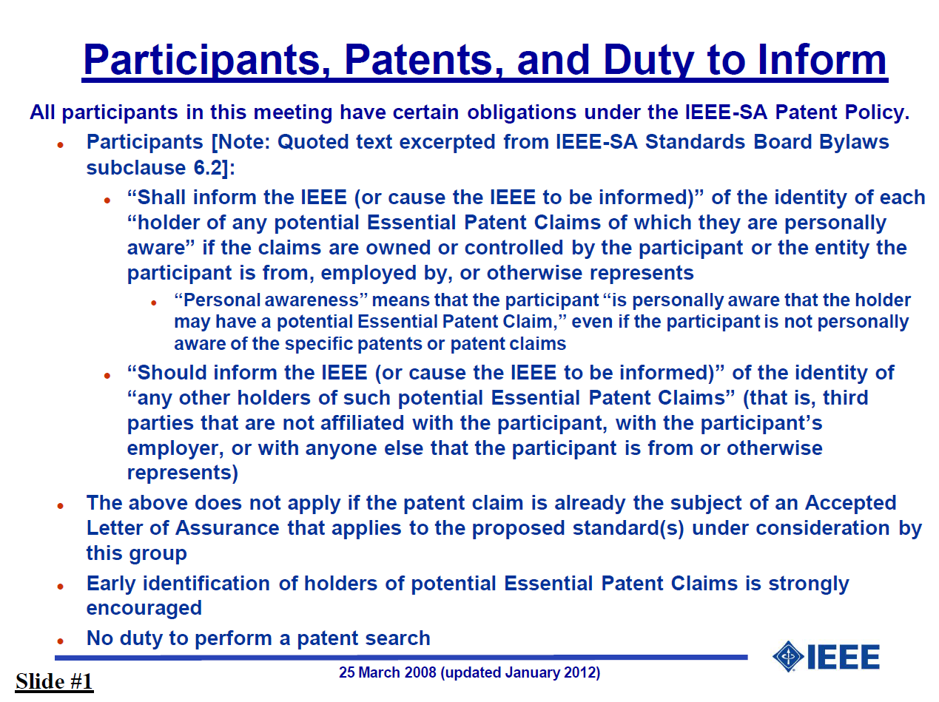
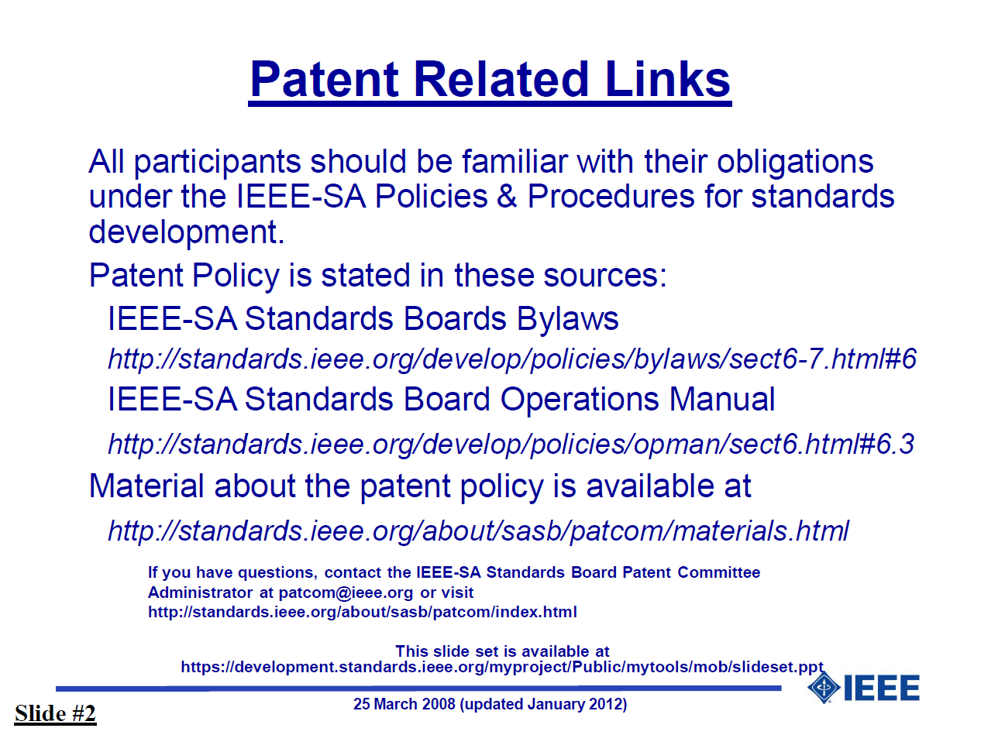
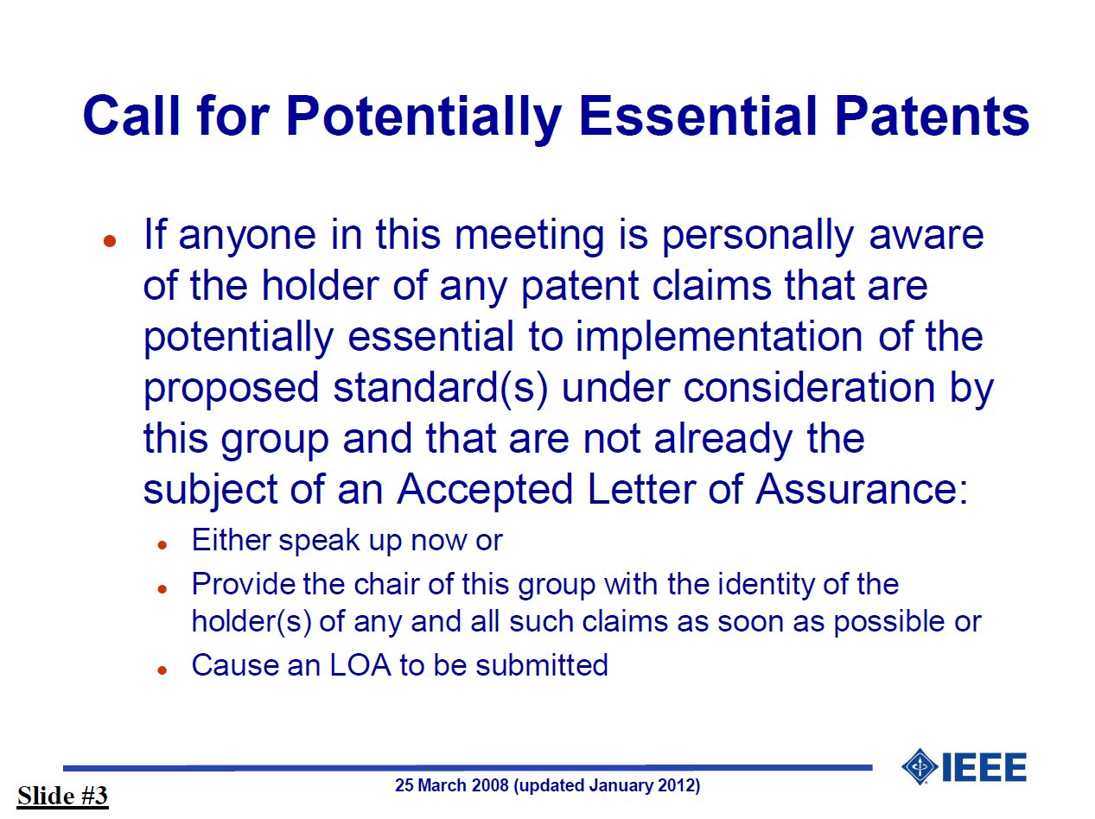
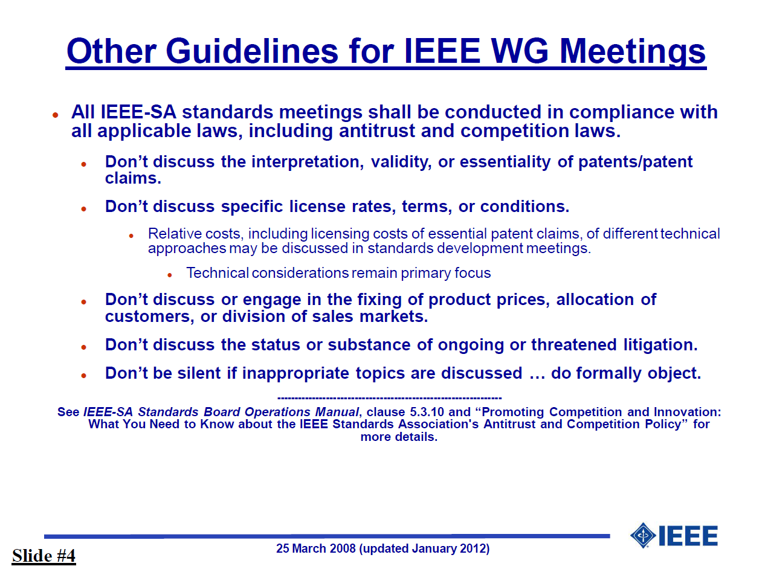
IEEE-SA patent policy and call for patents
IEEE patent policy:
http://standards.ieee.org/board/pat/pat-slideset.pdf
Call for Potentially Essential Patents

Slide 4
Approval of the Agenda
Call to order
Roll call
IEEE-SA patent policy and call for patents
Approval of agenda
Approval of previous meeting minutes of December 1,2014
Officer announcements
SystemC AMS change requests
SystemC AMS LRM technical documentation process
AOB
Next meeting: February 2, 2015 at 17:00h CET
Adjournment
Make a motion to approve the agenda

Slide 5
Approval of previous meeting minutes
Meeting minutes of December 1,2014
Make a motion to approve the minutes

Slide 6
Officer Announcements
Results of officer voting
Companies which were eligible to vote: NXP, ST, Cadence, Fraunhofer, Atrenta
  IEEE-SA rule: voting right for companies which attended the last 2 meetings
Voting is valid in both cases, as we have a majority of eligible voters.
In line with the IEEE-SA policies and procedures, the sponsor committee (DASC) which needs to affirm the election of these officers.
  DASC voting closes January 5 end-of-day
Name | Role | #eligible voters | Approved | Abstain | Reject
Martin Barnasconi | Chair | 5 entities | 4 | 1 | 0
Karsten Einwich | Secretary | 5 entities | 4 | 1 | 0

Slide 7
SystemC AMS change requests (1)
CR980: Initial value of vector
CR1006/1061: remove hierarchical decoupling port
CR1036: Add sc_in/sc_out constructors
CR1046: rename phi0 -> psi0
CR1062: Semantics of delay changes
CR1063: sca_module argument should be const-ref
CR1067: Initial value of CT port at t=0
CR1070: Remove const-ness for argument for assignment operator= converter and decoupling output ports

Slide 8
SystemC AMS change requests (2)
CR1071: Define access function for ac and ac-noise simulation for the decoupling ports sca_out<T,SCA_CT/DT_CUT>
CR1072 (NEW): Make read methods of converter ports and trace variable object consistent (non-const)
Updated document (v3) available in Twiki member area

Slide 9
SystemC AMS technical documentation process (1)
Deliverable of the P1666.1 WG: Language Reference Manual (LRM)
Input document received from Accellera: SystemC AMS 2.0 LRM
  Current format: Docbook XML
  Pictures/graphics in vector format (SVG)
  Formulas in MathML XML
Challenges
  IEEE-SA does not have a qualified XML based technical documentation flow available (currenly only supports Framemaker or Word)
    Rewriting and editing in Framemaker or Word formats not seen as sustainable solution
  DITA XML has become the defacto industry standard w.r.t. technical documentation instead of DocBook
Proposed publication process for P1666.1:
  Publishing flow based on DITA XML and Open Toolkit (DITA OT), an open source Java (ant) based flow
  Main output format PDF. Alternatives considered: HTML5 and epub
  May serve as pilot for IEEE-SA XML based technical documentation flow

Slide 10
SystemC AMS technical documentation process (2)
Technical activities and specialties introduced
  Application of XSLT style sheets to translate Docbook XML to DITA XML
  Creation of style sheet for PDF document compatible with IEEE-SA Standards Style Manual (DITA OT plugin)
  Embedding and correct rendering of MathML formulas (JEuclid)
  Syntax/code highlighting (XSLTHL extensions)
  Change bars/highlighting (DiffMk?)
Note: no focus on editing/authoring environment – use your favorite XML editor, or
  oXygenXML (DITA works out-of-the-box)
  Adobe Framemaker (needs some tweaking)
  OpenOffice (needs more tweaking)
  Microsoft Office (needs heavy tweaking)
SVN repository for DITA XML source files: https://svn.eas.iis.fraunhofer.de/systemc-ams-p16661
  Ask Karsten for read access
Rendered PDF documents (for review process) will be posted regularly on the private Twiki page

Slide 11
SystemC AMS technical documentation process (3)
Timing (same as reported in December 2014):
Q1-2015:
  Identify inconsistencies, incorrectness, incompleteness in existing LRM
Q2-2015:
  LRM update, first IEEE draft of P1666.1 available
  Start WG review

Slide 12
Any other business
P1666.1 Operations manual being created
  Informal document, including more details and clarity on membership types, required attendance, voting rules, etc.
Attendance tracking page on Twiki:
  http://www.eda.org/twiki/bin/view.cgi/P16661/AttendanceTracking
  Please let me know if your company attendance is not tracked correctly
AOB of the attendees

Slide 13
Next meeting & Adjournment
February 2, 2015
5:00pm CET
Draft agenda:
http://www.eda.org/twiki/bin/view.cgi/P16661/February2%2c2015
Make a motion to adjourn
the meeting
(no second)

