Slide 1
P1666.1
SystemC Analog/Mixed-Signal (AMS) extensions Working Group
December 7, 2015 | Martin Barnasconi | P1666.1 Chair

Slide 2
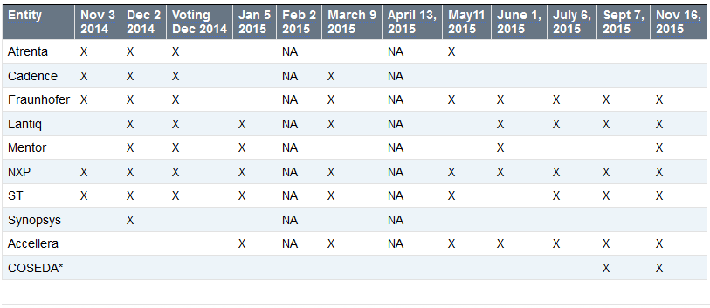
Call to order & Roll CAll
Attendance tracking to date:
Voting rights* today (at start of meeting):
NXP
Fraunhofer
Accellera
ST
Lantiq
* Entities with voting rights should have attended two of the last three meetings.

Slide 3
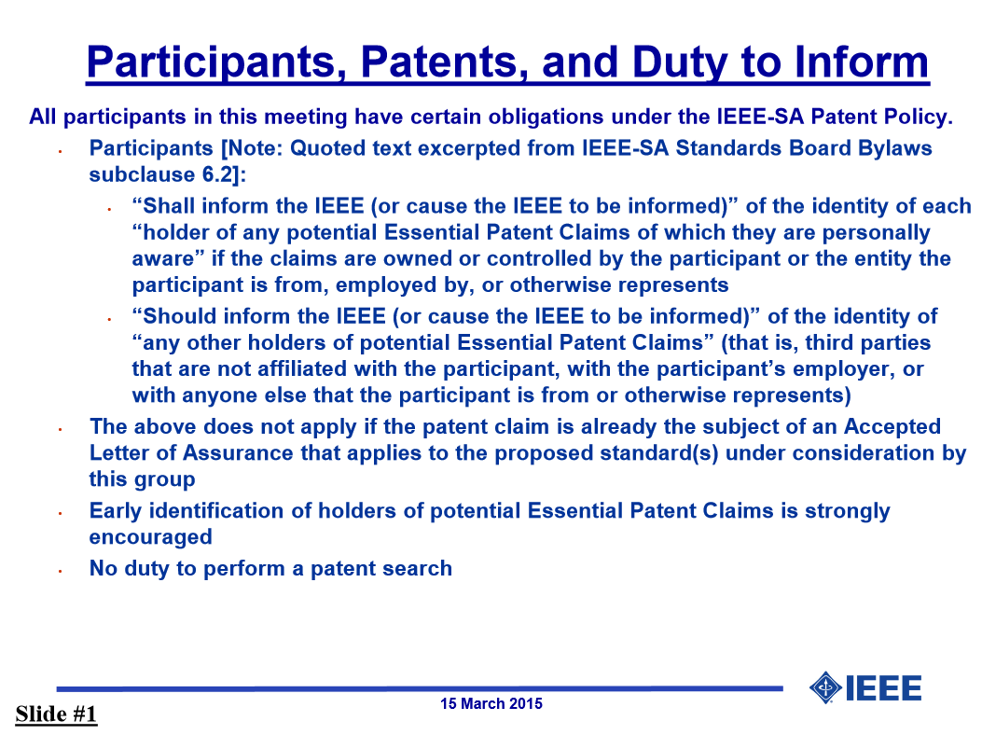
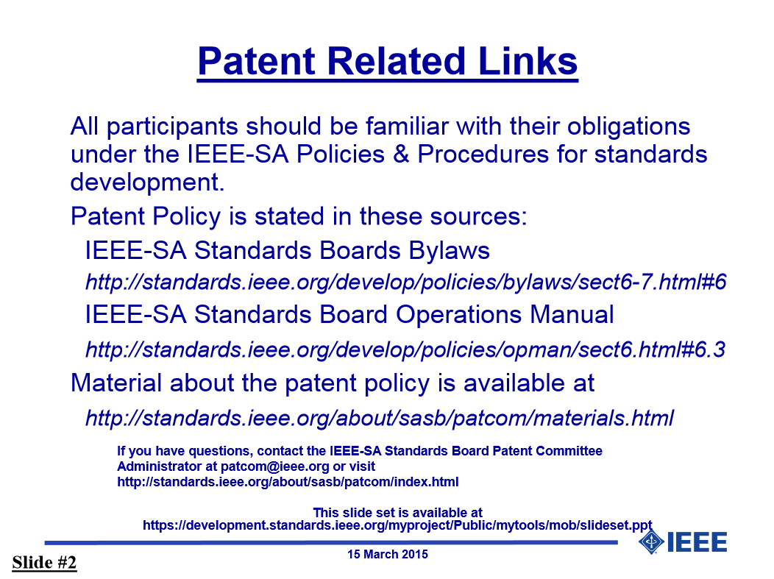
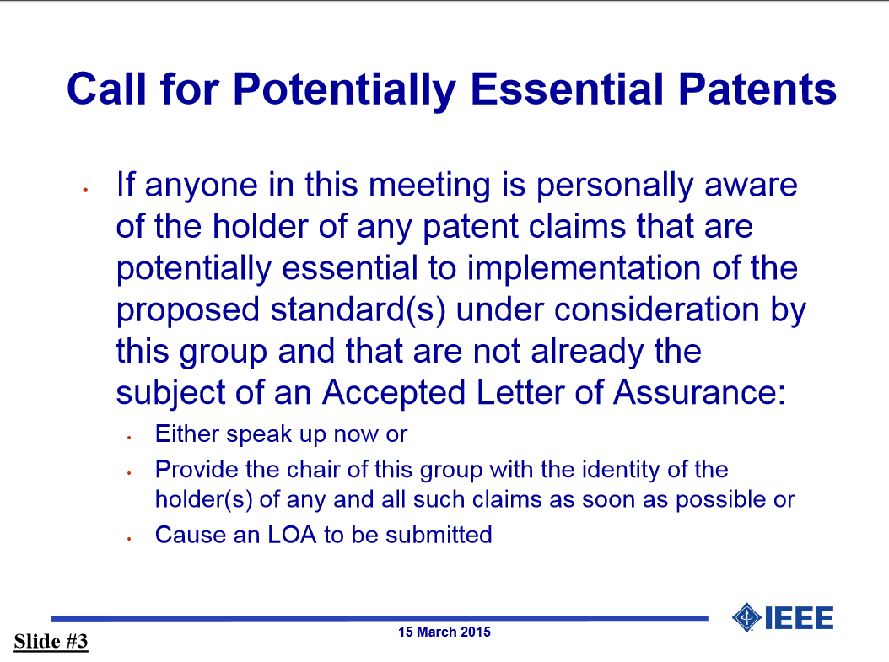
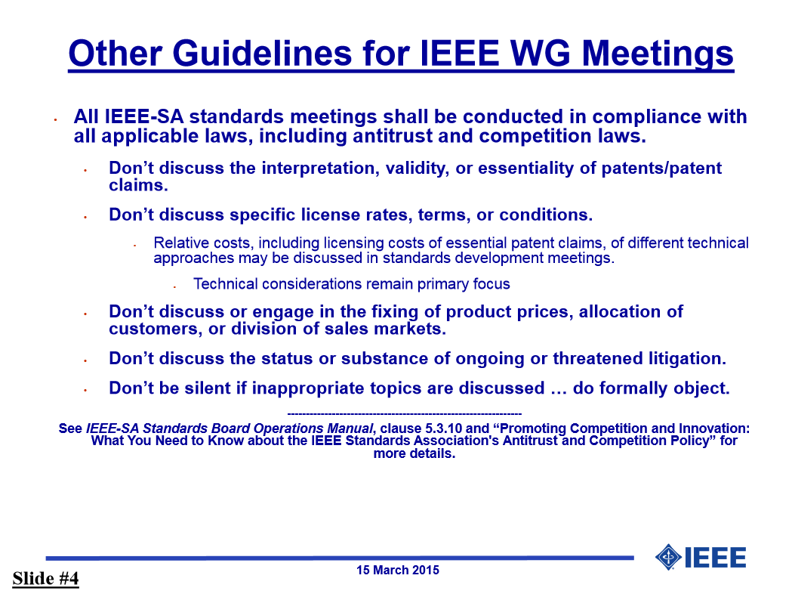
IEEE-SA patent policy and call for patents
IEEE patent policy:
Presentation can be found here: http://standards.ieee.org/board/pat/pat-slideset.pdf
Call for Potentially Essential Patents

Slide 4
Approval of the Agenda
Call to order
Roll call
IEEE-SA patent policy and call for patents
Approval of agenda
Approval of previous minutes November 16, 2015
Ballot resolution / P1666.1 document version D5 / Ratify D5 version
Status of IEEE public review
AOB
Next meeting
Adjournment
Make a motion to approve the agenda

Slide 5
Approval of previous meeting minutes
Meeting minutes November 16, 2015
Make a motion to approve the minutes

Slide 6
Ballot resolution / P1666.1 document version D5
Ballot resolution document:
Total comments: 16
Accepted: 8
Rejected: 8
Revised: 0
File: http://www.eda.org/twiki/pub/P16661/MemberArea/p16661_ballot_comments_resolution.xlsx
Resolution results uploaded to Sponsor Ballot portal on IEEE-SA website: https://development.standards.ieee.org/b1080700002/voter-response-detail
P1666.1/D5 version of the LRM including the updates:
http://www.eda.org/twiki/pub/P16661/MemberArea/P1666.1_D5_Dec_7_2015.pdf
http://www.eda.org/twiki/pub/P16661/MemberArea/P1666.1_D5_redlined_Dec_7_2015.pdf
All changes listed in document:
http://www.eda.org/twiki/pub/P16661/MemberArea/P1666_1_changes_d4_to_d5.docx
Ratification of the D5 version for re-circulation ballot

Slide 7
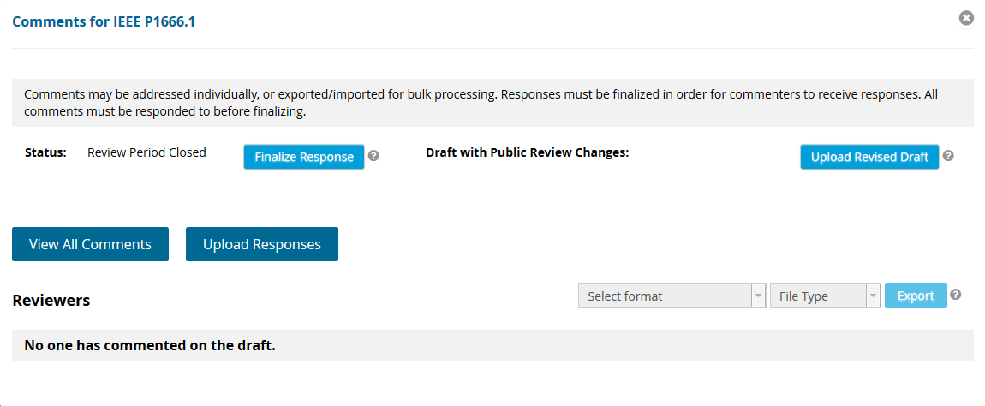
Status of IEEE public review
No comments received, see below

Slide 8
Any other business
Attendance tracking page on Twiki:
http://www.eda.org/twiki/bin/view.cgi/P16661/AttendanceTracking
Please let me know if your company attendance is not tracked correctly
AOB of the attendees

Slide 9
Next meeting & Adjournment
January 11, 2015
5:00pm CET
Please let me know if you have additional items for the agenda
Make a motion to adjourn the meeting (no second)

